Slide 1
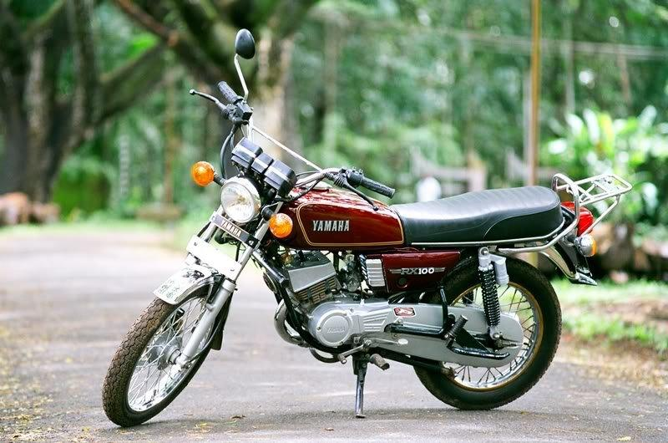
old gold Bike
TITLE : old gold Bike SUBTITLE : Oops mini-Project PRESENTER : Mohanraj.m COURSE : Python

Slide 2
Tools :
Python 3.13
Operators
Condition statement
For loop
String
Functions
Scope of the function
Modules
Random
Time
Pywhatkit
Os
Pyautogui
qrcode
Packages
Pygame

Slide 3
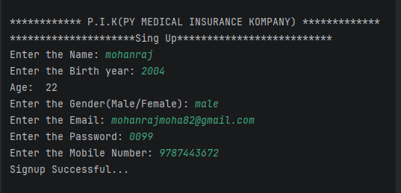
Use Table : Name, Age , Gender, Contact, Email,
password

Slide 4
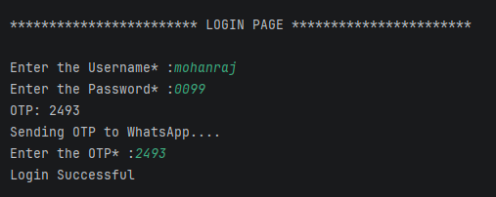
Use Table : User
id, password, OTP
Use :
Functions
Condition statement
OTP-Random
M.send-pywhatkit

Slide 5
Bike model – condition statement
Bike Image – pygame
Bike Details(model,color,price) - oops-class,objcets,
Inheritence(muitiple inheritence)
4. Pay Bills – Qrcode
5. Qrcode image – pygame
6. Time(Sleep) – wait for next code run

Slide 6
Thank You

